Slide 1
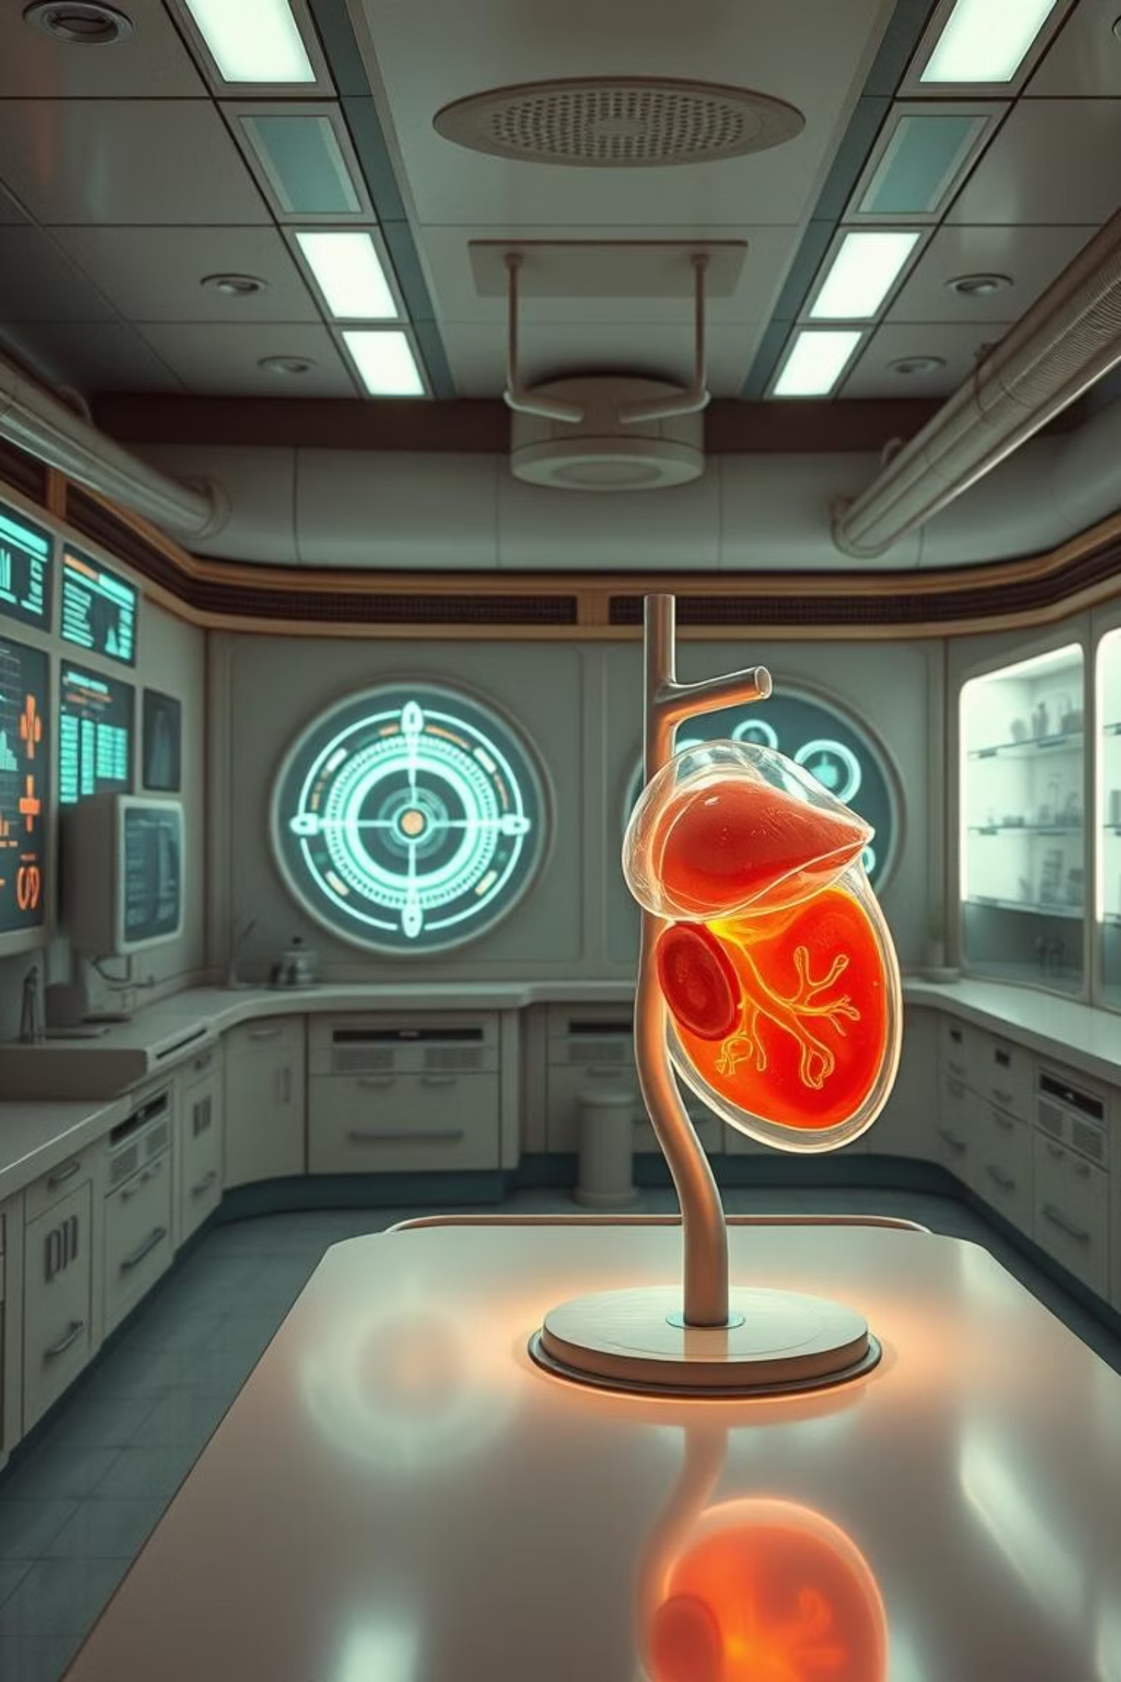
Revolutionizing Liver Care
Predicting Liver Cirrhosis using Advanced Machine Learning
Team ID: LTVIP2025TMID33878

Slide 2

The Challenge: Late Detection
Life-Threatening
Costly Diagnostics
Early Prediction
Liver cirrhosis often detected in advanced stages, reducing treatment effectiveness.
Current methods are invasive and expensive, burdening patients and healthcare systems.
Timely diagnosis can significantly improve patient outcomes and save lives.

Slide 3
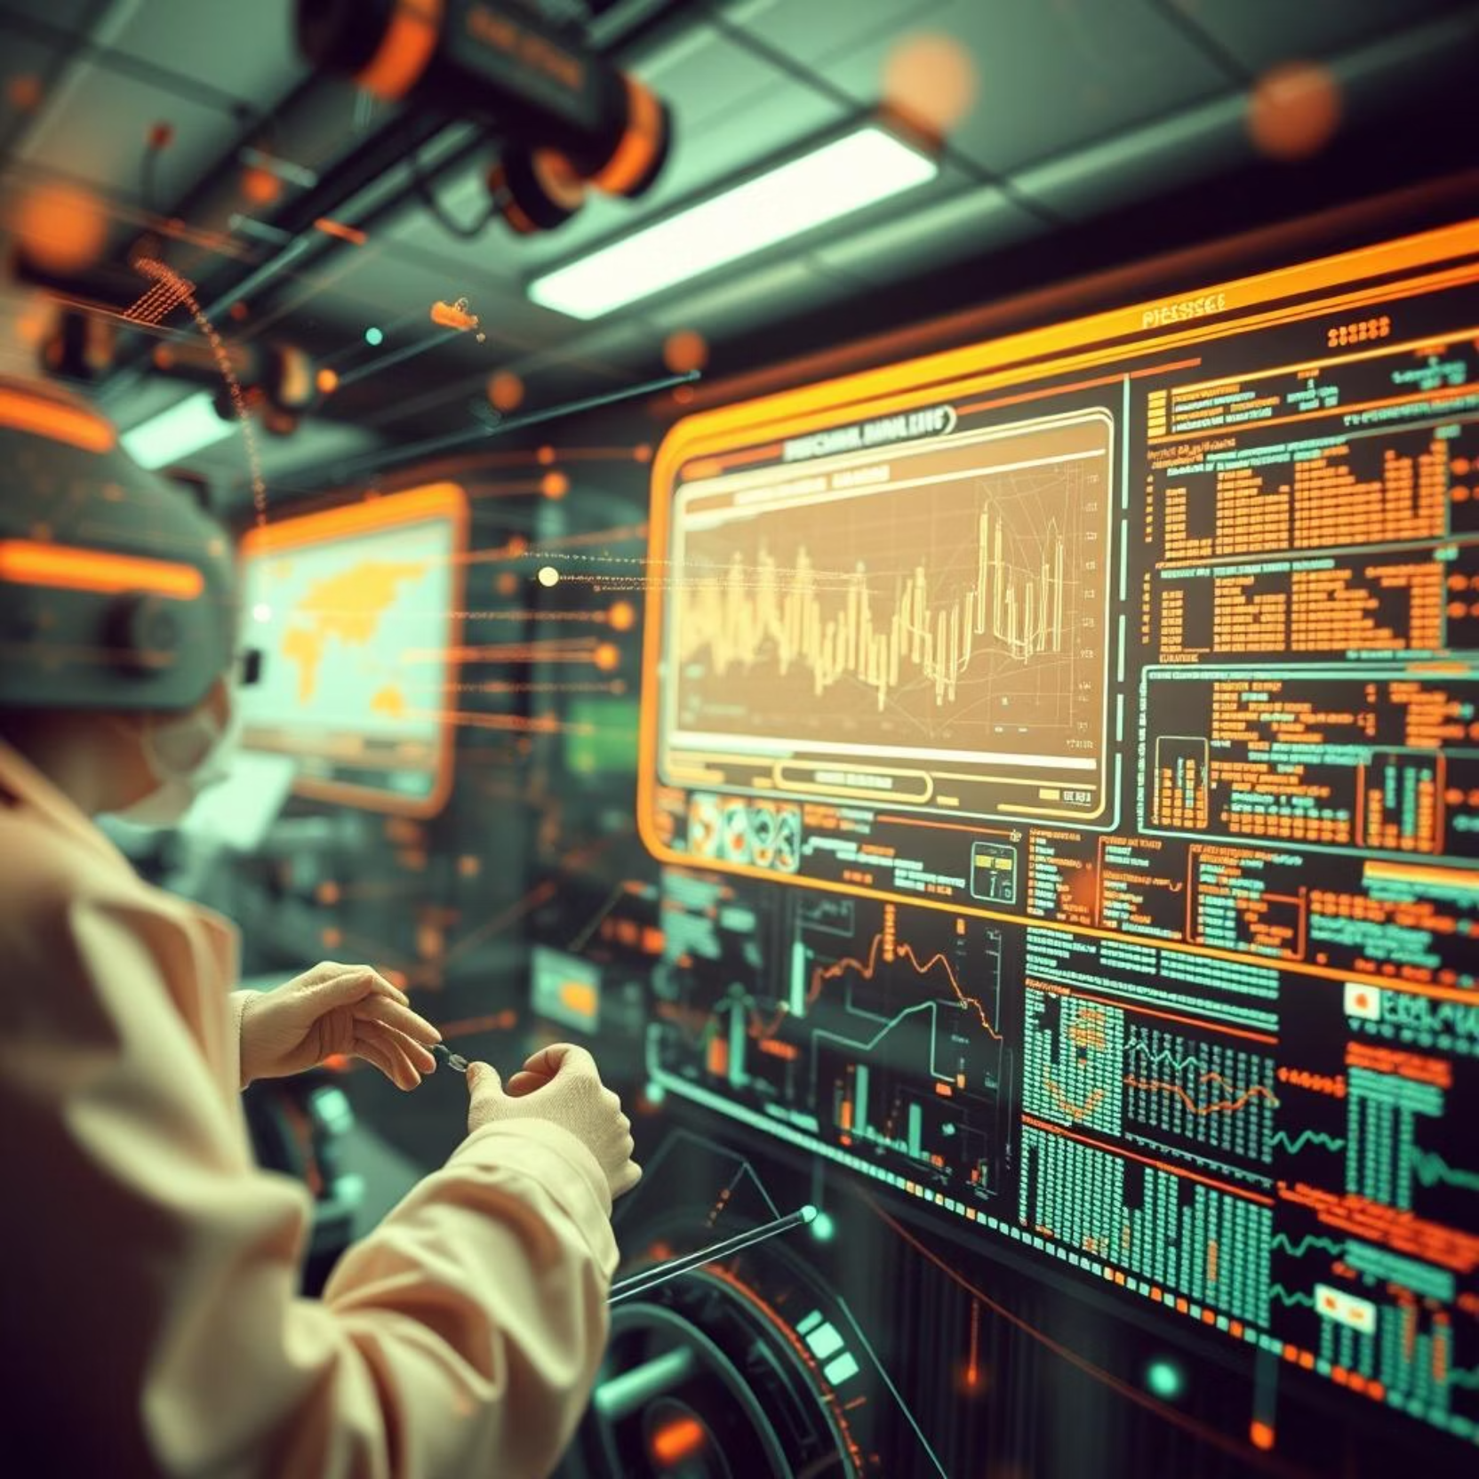
Our Objective: Early Prediction
Develop a non-invasive machine learning system for early liver cirrhosis detection.
Rapid Diagnosis
Provide quick, reliable insights for medical professionals.
Non-Invasive
Utilize patient data without painful or risky procedures.
Improved Outcomes
Facilitate earlier intervention and better patient management.

Slide 4
Dataset: UCI Liver Cirrhosis
Source
UCI Liver Cirrhosis
Features
Age, Gender, Bilirubin
Key Features
Albumin, Prothrombin Time
Target Variable
Status (Alive/Dead)
Preprocessing
Missing Value Handling
Preprocessing
Data Normalization

Slide 5
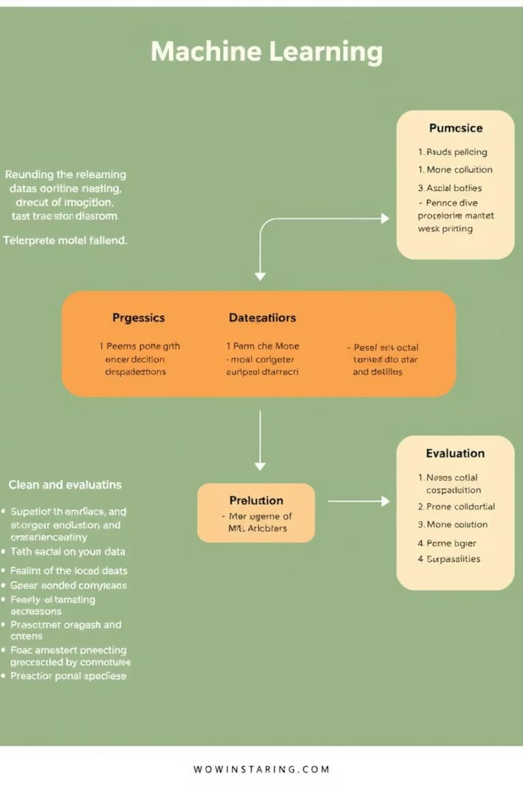




Methodology: Our Approach
Data Preprocessing
Cleaning and Scaling
Train/Test Split
Data Partitioning
Model Training
Random Forest, Logistic Regression
Evaluation
Accuracy, Precision, Recall, AUC

Slide 6
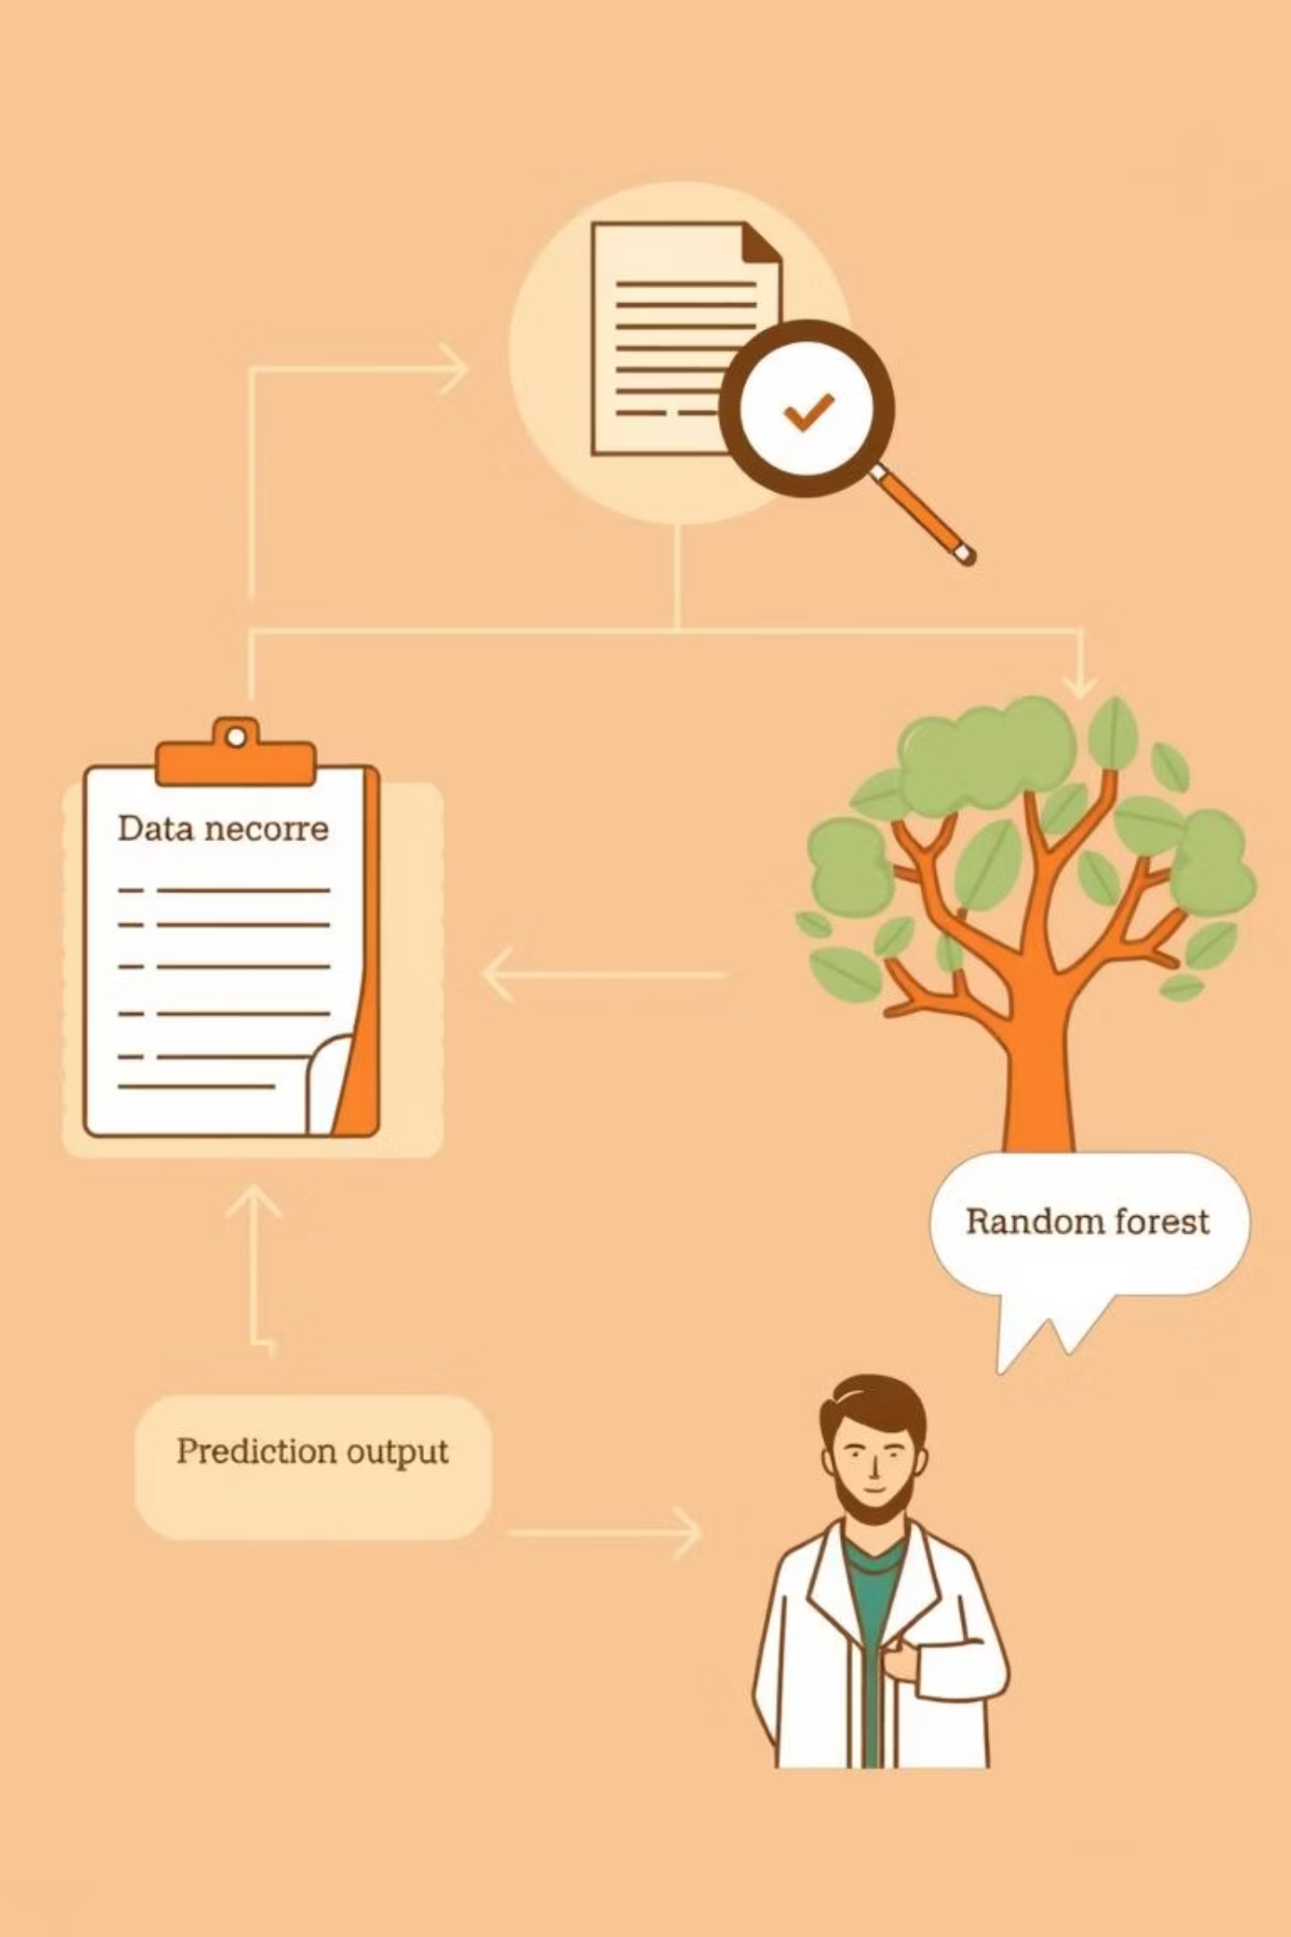
Model Architecture Flow
Data Input
Patient clinical records
Preprocessing
Cleaning, scaling, feature engineering
ML Model
Random Forest Classifier
Prediction Output
Cirrhosis risk assessment

Slide 7
Performance Results
92%
88%
Accuracy
Precision
Overall correct predictions
True positives among all positive predictions
95%
0.94
Recall
AUC Score
True positives among all actual positives
Model's ability to distinguish between classes

Slide 8
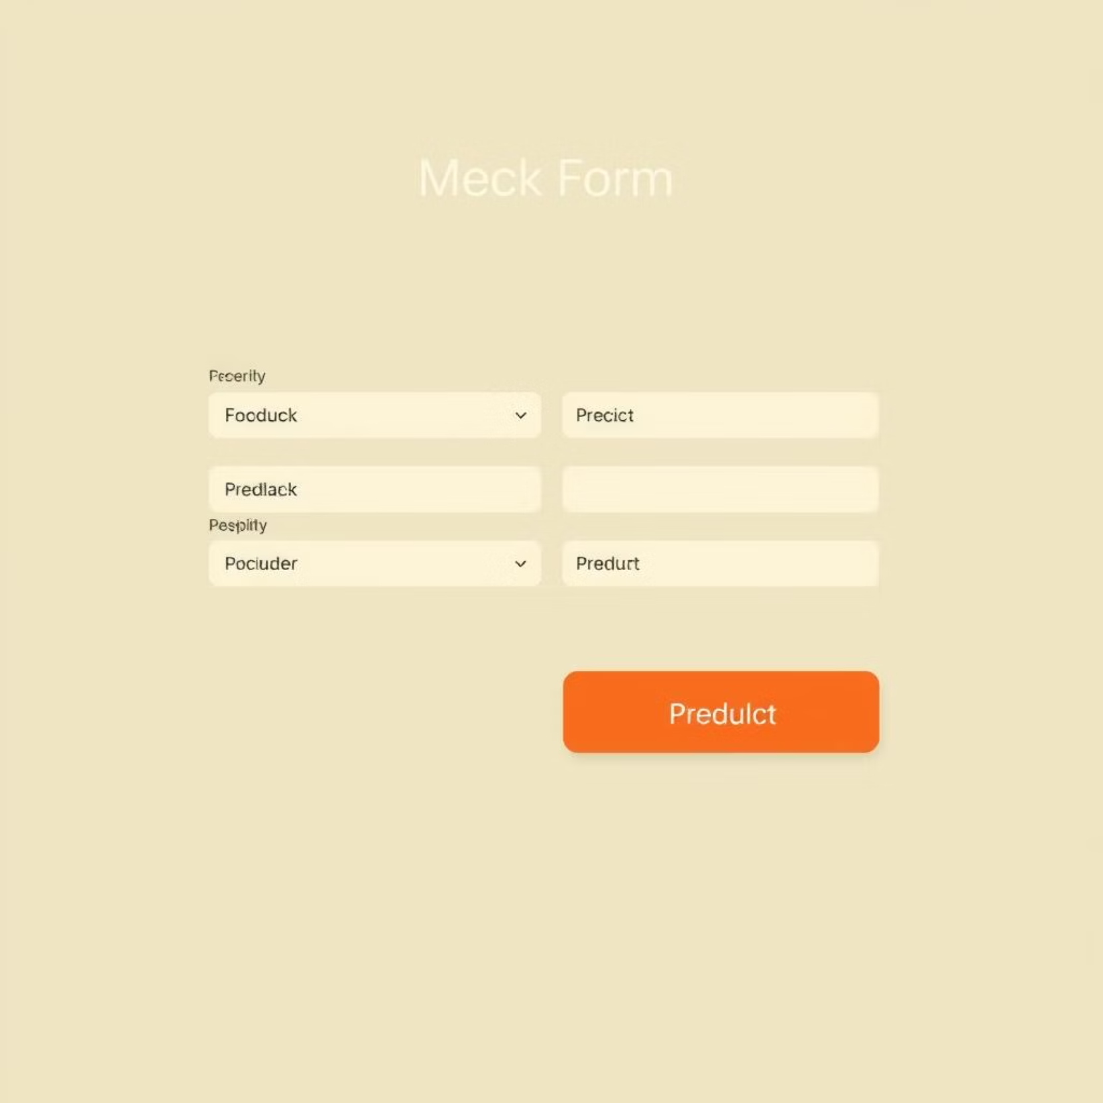
Web Application Interface
User-friendly interface developed using Streamlit.
Intuitive patient data input.
Instant prediction display.
Designed for medical professionals.

Slide 9
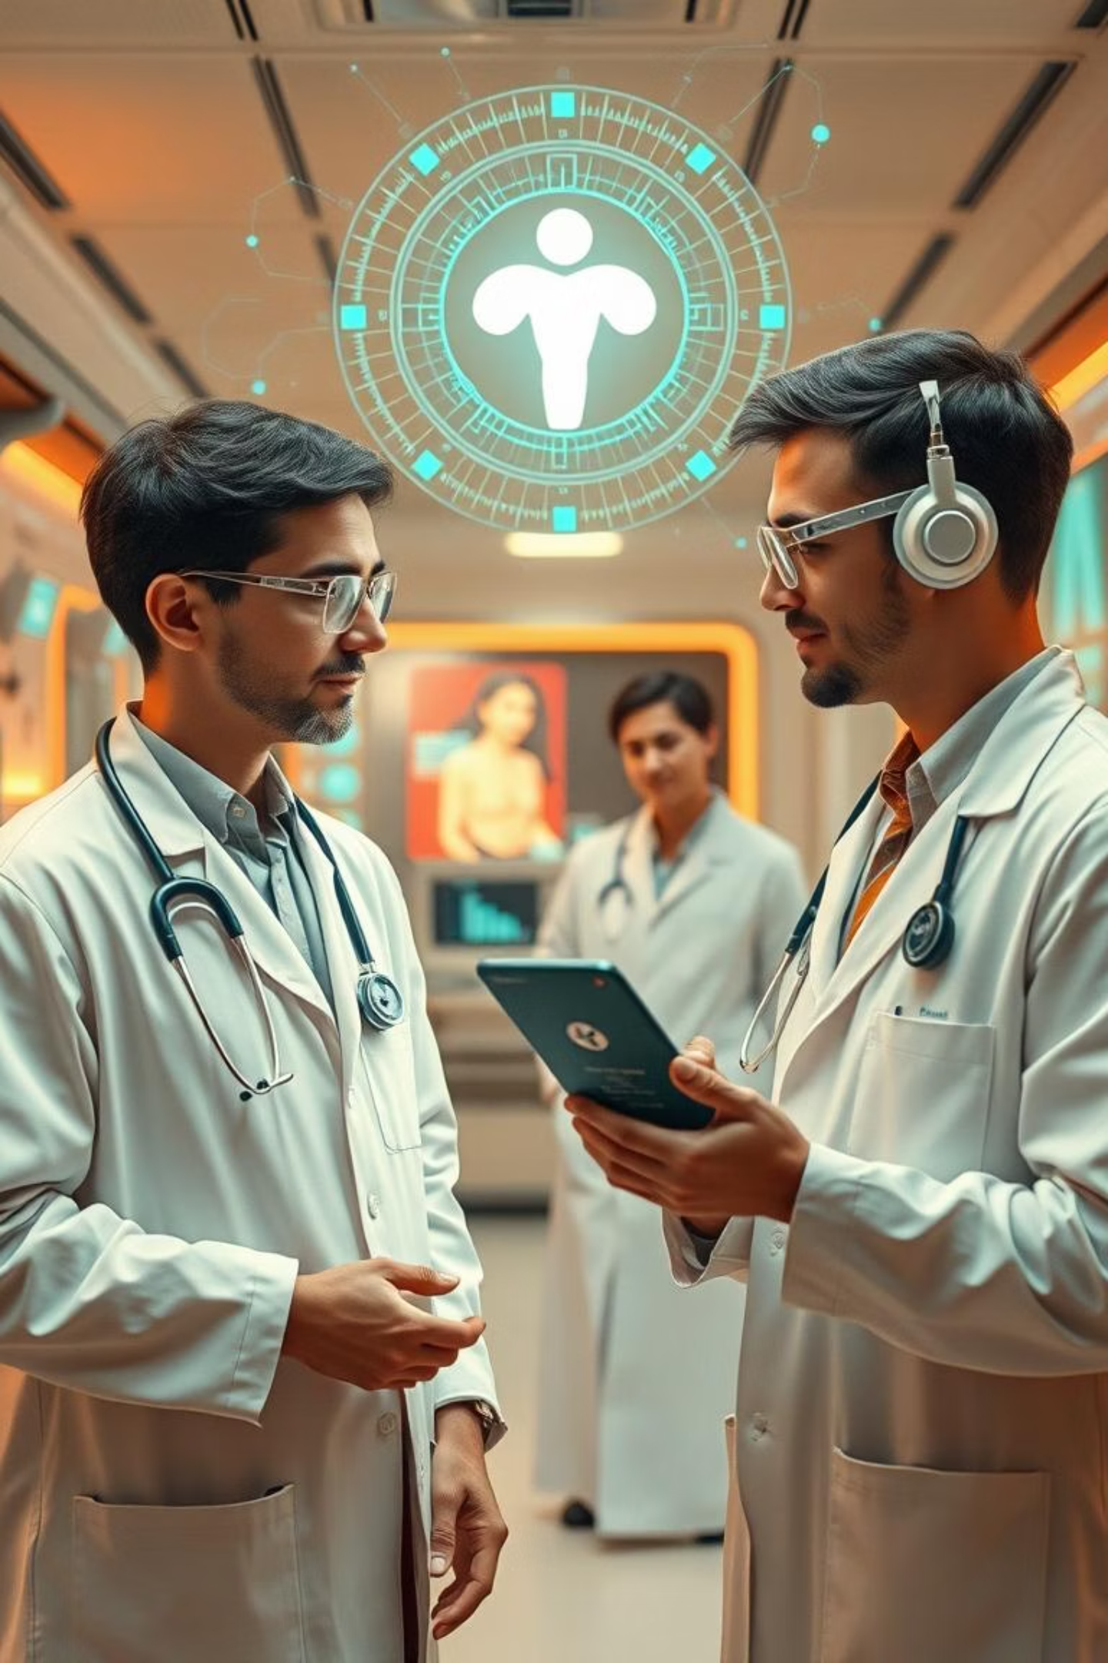




Future Scope & Expansion
Clinical Integration
Collaborate with hospitals for real-world data and validation.
Mobile Version
Develop a mobile application for on-the-go access.
EHR Integration
Seamlessly integrate with Electronic Health Records systems.
Advanced Features
Incorporate genomics and additional clinical biomarkers.

Slide 10
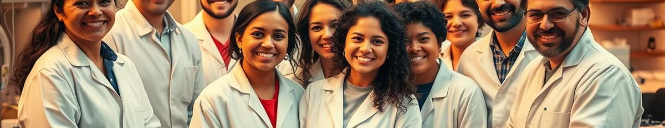
Thank You!
We are open to your questions and feedback.

